Slide 1
BigDL: a Distributed Deep Learning Library on Spark
Zhichao Li
Big Data Technology Team, Software and Service Group, Intel

Slide 2
Outline
What’s BigDL
Why BigDL
Inside BigDL
What can BigDL do

Slide 3
WhAT IS BigDL?

Slide 4

BigDL: Deep learning on Apache Spark*
BigDL open sourced on Dec 30, 2016
Apache Spark*, MKL Acceleration, High performance
Rich function
Scala/Java + Python
AlexNet, GoogleNet, VGG, Faster R-CNN, SSD, Deep Speech, Recommendation…
TensorBoard, Notebook, caffe/torch/tensorflow load/export…
Popularity
Support from Cloud: Microsoft, Amazon, Cloudera, Databricks…

Slide 5
Basic Component
Layers
113+ layers (Conv, 3D Conv, Pooling, 3D Pooling, FC …)
Criterion
23+ criterions (DiceCoefficient, ClassNLL, CrossEntropy …)
Optimization
SGD, Adagrad
Community contribution: Adam, Adadelta, RMSprop, Adamx
Tensor:
ND-array data structure
Generic data type
Rich and fast math operations (powered by Intel MKL)

Slide 6
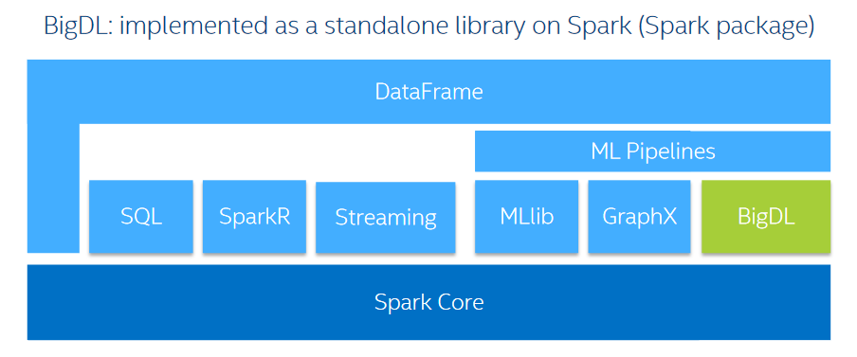
What is BigDL?
BigDL is a distributed deep learning library for Apache Spark*

Slide 7
Why BigDL?

Slide 8










Why BigDL
There’re a lot of deep learning frameworks. Only list a part of them

Slide 9
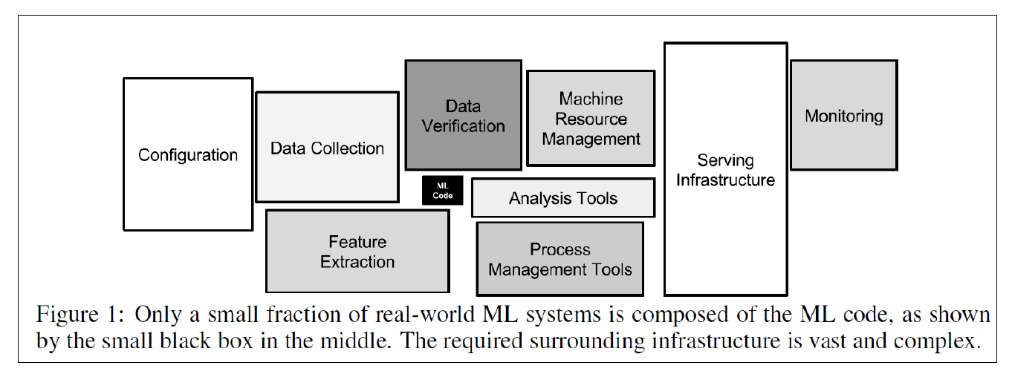
Why BigDL?
Production ML/DL system is Complex and Distributed. Spark-based Deep Learning library is a natural fit

Slide 10
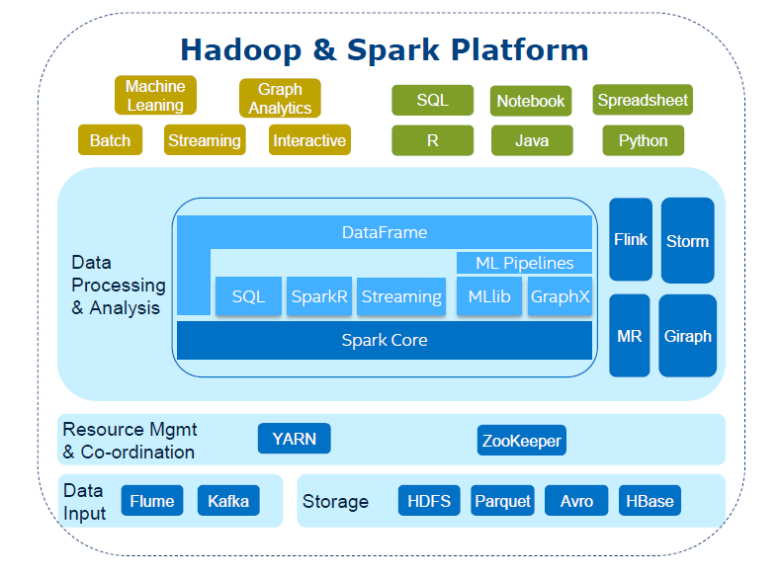
Why BigDL
BigDL: Run deep learning on Big Data platform
Outstanding features
Massively distributed
Fault tolerance
Elasticity
Dynamic resource sharing
…
Notes:
Close to your data. Easier to analyze a large amount of data on the same cluster where the data are stored
Quickly build end-to-end deep learning solution for your big data
Manage various big data analytics workload in one cluster, better leverage your machines

Slide 11
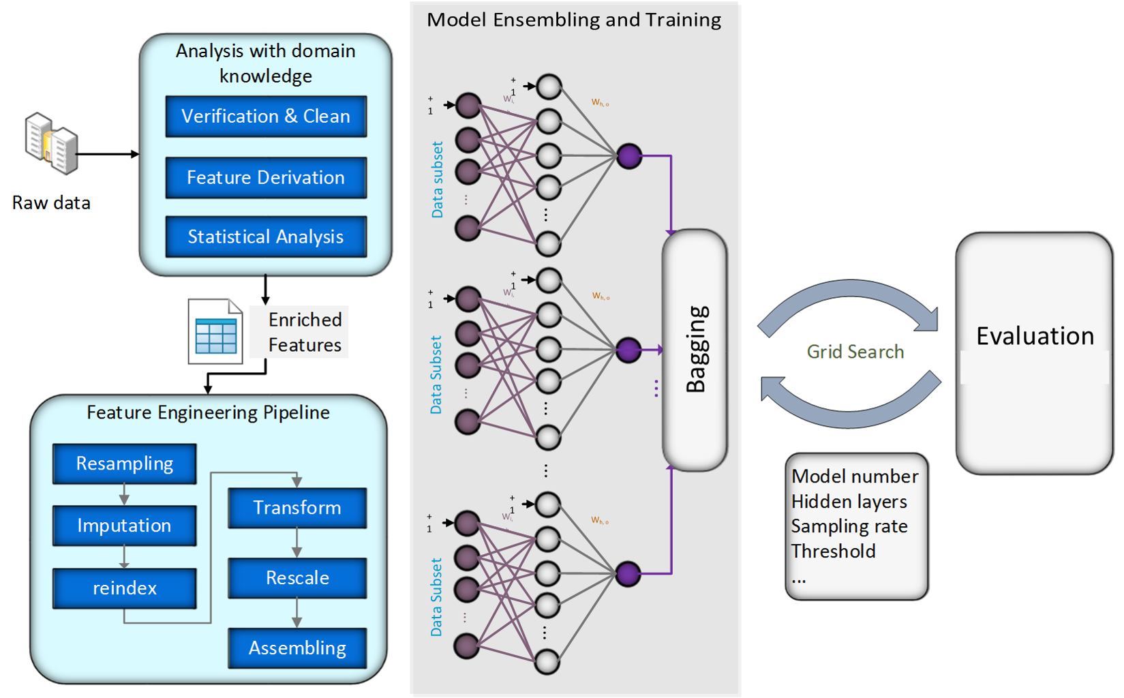
FinTech: Transaction Fraud Detection
Historical data is stored on Hive
Data preprocessing with SparkSQL
Spark ML pipeline for complex feature engineering
Use multiple BigDL CNN models
Use Sample+Bagging to solve unbalance problem
Grid search for hyper parameter tuning
Powered by BigDL

Slide 12
BigDL Features
Single node Xeon performance
Benchmarked to be best on Xeon E5-26XX v3 or E5-26XX v4
Orders of magnitude speedup vs. out-of-box open source Caffe, Torch
Scaling-out
Efficiently scales out to 10s~100s of Xeon servers on Spark

Slide 13
Why BigDL
People use BigDL to build applications
Large internet company
Financial company
Manufactory company
Medical school
Image, Recommendation, Fraud detection, Audio, NLP

Slide 14
Inside BigDL

Slide 15
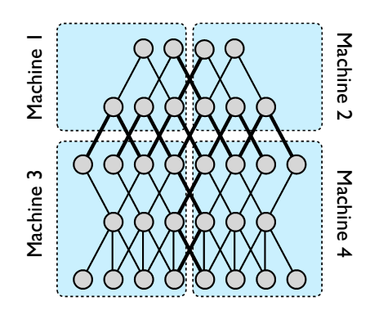
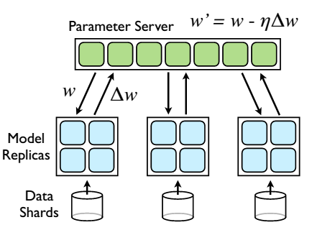
Pattern
Model Parallelism
Data Parallelism
Source: Dean J, Corrado G, Monga R, et al. Large scale distributed deep networks[C]//Advances in neural information processing systems. 2012: 1223-1231.

Slide 16
Communication Model
Task
Task
Driver
Task
Task
Task
Task
All to one
Parameter Server
11
10
35
Task
35
14
4
7
2
35
Task
Task
35
35
35
5
1
35
6
2
5
1
6
Task
All reduce (tree aggregation)
All reduce

Slide 17
Bulk Synchronous Parallel (BSP)
worker1
1
2
3
worker2
1
2
3
worker3
1
2
3
worker4
1
2
3

Slide 18
Asynchronous Synchronous Parallel (ASP)
worker1
1
2
worker2
1
2
3
4
5
worker3
1
2
3
worker4
1
2
3
4
Source: Dean J, Corrado G, Monga R, et al. Large scale distributed deep networks[C]//Advances in neural information processing systems. 2012: 1223-1231.

Slide 19
Distributed deep neural network on Spark
Data shards
Data shards
Utilize Spark to Scale out on multiple CPU cluster
Trainer synchronize to each other through All-reduce or ParameterServer
CPU
CPU
CPU
CPU
CPU
CPU
CPU
CPU
CPU
CPU
BigDL
BigDL
All-reduce or ParameterServer
Spark

Slide 20
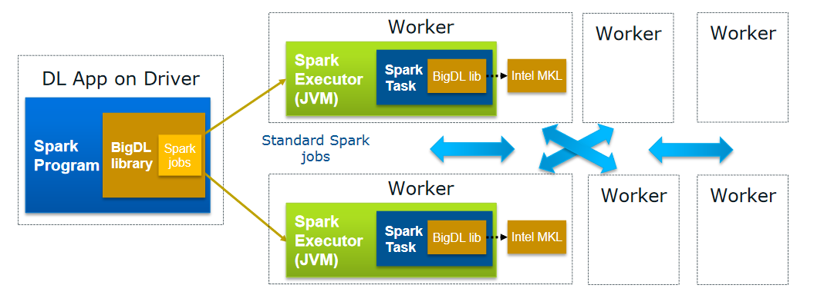
BigDL Features
Distributed Deep learning applications on Apache Spark*
No changes to the existing Hadoop/Spark clusters needed

Slide 21
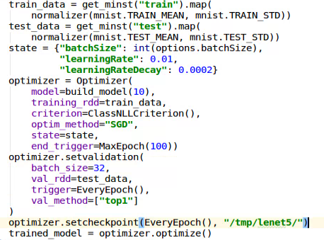
Python API Support
Based on PySpark, Python API in BigDL allows use of existing Python libs:
Numpy
Scipy
Pandas
Scikit-learn
Matplotlib
…

Slide 22
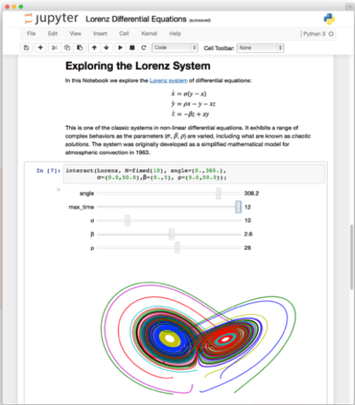
Jupyter Notebook support
Running BigDL applications directly in Jupyter notebooks
Share and Reproduce
Notebooks can be shared with others
Easy to reproduce and track
Rich Content
Texts, images, videos, LaTeX and JavaScript
Code can also produce rich contents
Rich toolbox
Apache Spark, from Python, R and Scala
Pandas, scikit-learn, ggplot2, dplyr, etc

Slide 23
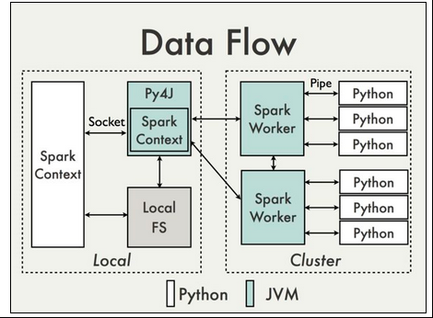
Python API
RDD[raw data]
Transform (python)
RDD[Samle(ndarray,ndarray)]
Train(python model)

Slide 24
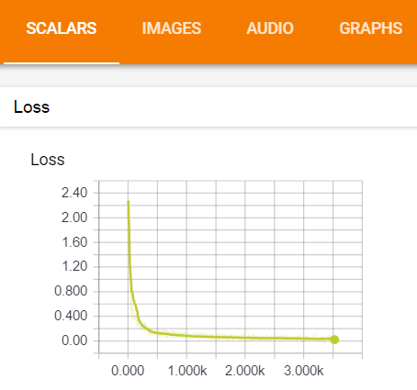
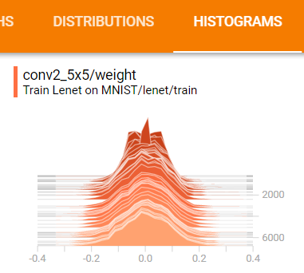
Visualization of optimization process - tensorboard
BigDL integration with TensorBoard
TensorBoard is a suite of web applications from Google for visualizing and understanding deep learning applications

Slide 25
BigDL integration with spark ml
DataFrame
Integrates with Spark-ML Pipeline:
Wrapper with Spark ML Transformer
BigDL Plugs into Spark ML pipeline
Support Spark v1.5/1.6/2.0/2.1
Transfomer1
Transfomer2
…
DLClassifer

Slide 26
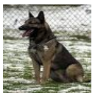

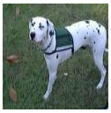
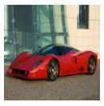
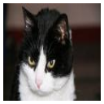
Tight Integrations with Spark SQL, DataFrame and Structured Streaming
BigDL Features
Kafka
File
Data Frame
(Batch/Stream)
df.select($’image’)
.withColumn(
“image_type”, ImgClassifier(“image”))
.filter($’image_type’ == ‘dog’)
BigDL UDF
Filtered Data Frame
(Batch/Stream)
*Image classification on ImageNet(http://www.image-net.org)

Slide 27
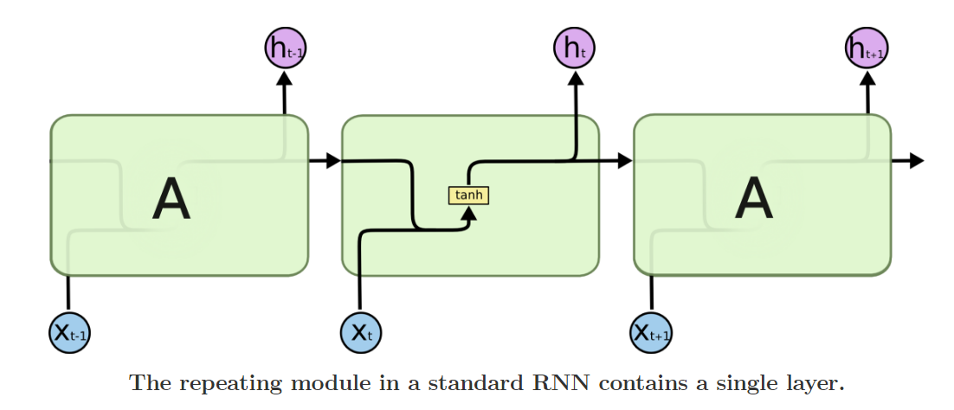
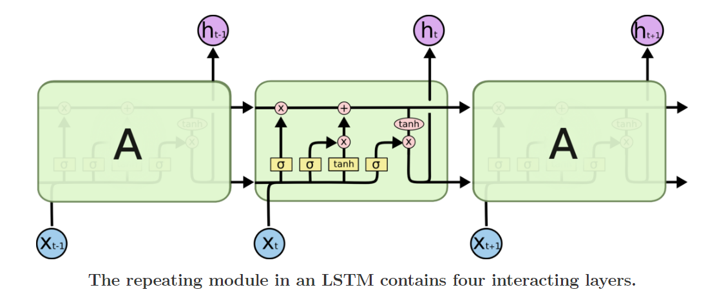
Natural Language Model - RNN
RNN:
Recurrent
BiRecurrent
Cell:
SimpleRNN
LSTM
GRU
LSTM with peepholes
Source: http://colah.github.io/posts/2015-08-Understanding-LSTMs/

Slide 28
BigDL: design for big data
Standard Spark Programs (Python and Scala)
Easy to deploy on top of Existing Spark or Hadoop clusters.
Rich deep learning support, close integrate with other big data work load
Interact with other deep learning framework.
High performance powered by Intel MKL and multi-threaded programming
Efficient scale-out with an all-reduce communications on Spark

Slide 29
What CAN BigDL do

Slide 30
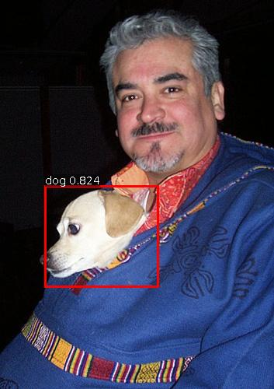
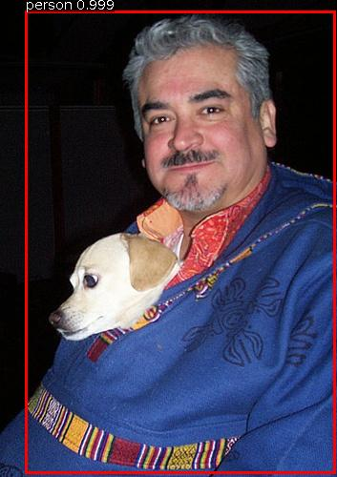
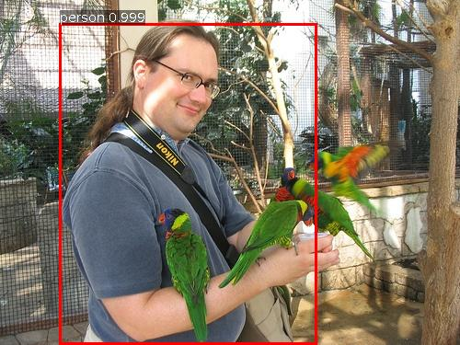
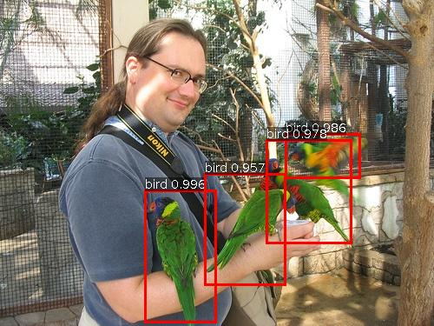
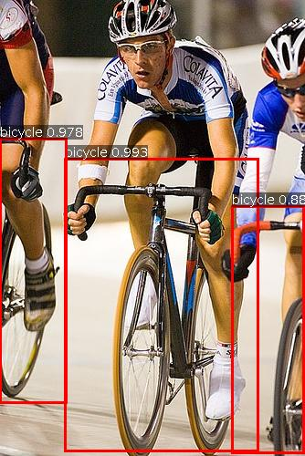
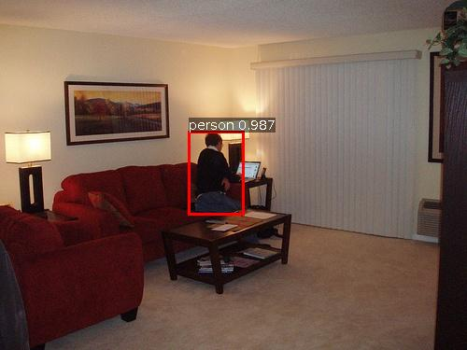
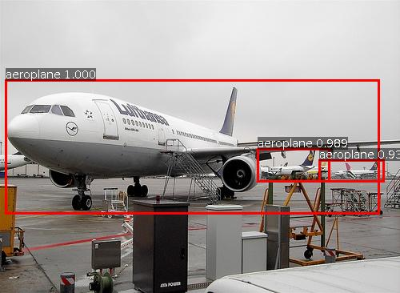
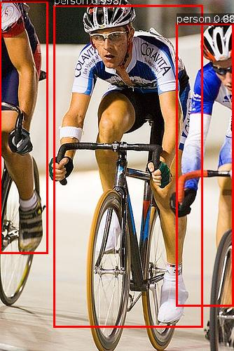
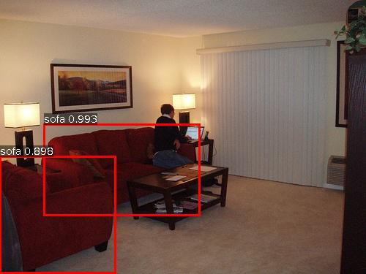
Object Detection on PASCAL
*(http://host.robots.ox.ac.uk/pascal/VOC/)

Slide 31
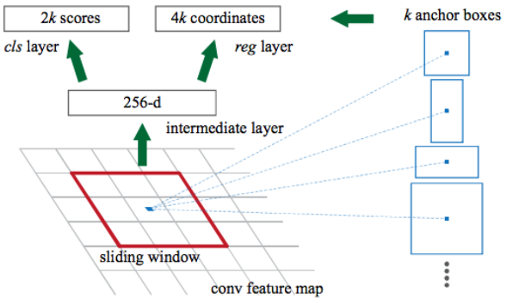
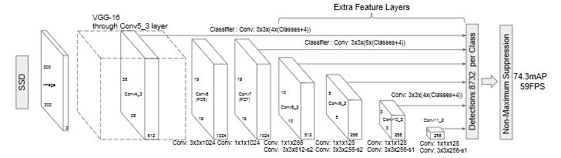
Visual recognition and Object Detection
Faster-RCNN
SSD: Single Shot MultiBox Detector

Slide 32
Model Persistent
BigDL Model File
Model Snapshot
Long training work checkpoint
Model deployment and sharing
Fine-tune
Caffe/Torch/Tensorflow Model Support
Model file load
Easy to migrate your caffe/torch/tensorflow
work to Spark
Caffe Model File
Load
BigDL
Torch Model File
Tensorflow Model File
Save
Storage

Slide 33
SSD Pipeline
RDD[ByteImage]
Raw Data
Pre-trained Model
prediction
Visualizer
Preprocess
Resize
BigDL SSD Model
Post-processor
Boxes & scores
Normalize
RDD[Tensor]
ToBatch
Ground Truth
MAP
Validation

Slide 34
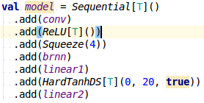
Deep Speech 2 on BigDL: Model
9 layers biRNN: >50 Million parameters

Slide 35
BigDL is an open source project
Positive feedback from community
1.7k+ stars,
Feature request from community(3D Conv, visualization …)
PRs from community
Already see some adoptions

Slide 36
Documents
Start with tutorials
https://github.com/intel-analytics/BigDL-Tutorials/
BigDL provide examples to help developer play with bigdl and start with popular models.
Vgg, Inception, AlexNet, ResNet, RNN
Text Classification, Image Classification, Load Torch/Caffe model
https://github.com/intel-analytics/BigDL/wiki/Examples
BigDL Out-of-box run scripts on AWS
https://github.com/intel-analytics/BigDL/wiki/Running-on-EC2

Slide 37
BigDL installation on major cloud frameworks.
“Apache Spark BigDL on Databricks” https://databricks.com/blog/2017/02/09/intels-bigdl-databricks.html
“BigDL on Cloudera’s CDH Data Science Virtual Machine” http://blog.cloudera.com/blog/2017/04/bigdl-on-cdh-and-cloudera-data-science-workbench/
“How to use BigDL on Apache Spark for Azure HDInsight” https://blogs.msdn.microsoft.com/azuredatalake/2017/03/17/how-to-use-bigdl-on-apache-spark-for-azure-hdinsight/
“BigDL on Microsoft’s Data Science Virtual Machine” Coming soon

Slide 38
BigDL installation on major cloud frameworks - 2.
“Apache Spark BigDL on AWS” https://github.com/intel-analytics/BigDL/wiki/Running-on-EC2
“Apache Spark BigDL for E-MapReduce on Ali Cloud ” https://yq.aliyun.com/articles/73347

Slide 39
BigDL On github
https://github.com/intel-analytics/BigDL

Slide 40
BIGDL Community
Join Our Mail List
bigdl-user-group+subscribe@googlegroups.com
Report Bugs And Create Feature Request
https://github.com/intel-analytics/BigDL/issues

Slide 41
Legal Disclaimer
INFORMATION IN THIS DOCUMENT IS PROVIDED IN CONNECTION WITH INTEL PRODUCTS. NO LICENSE, EXPRESS OR IMPLIED, BY ESTOPPEL OR OTHERWISE, TO ANY INTELLECTUAL PROPERTY RIGHTS IS GRANTED BY THIS DOCUMENT. EXCEPT AS PROVIDED IN INTEL'S TERMS AND CONDITIONS OF SALE FOR SUCH PRODUCTS, INTEL ASSUMES NO LIABILITY WHATSOEVER AND INTEL DISCLAIMS ANY EXPRESS OR IMPLIED WARRANTY, RELATING TO SALE AND/OR USE OF INTEL PRODUCTS INCLUDING LIABILITY OR WARRANTIES RELATING TO FITNESS FOR A PARTICULAR PURPOSE, MERCHANTABILITY, OR INFRINGEMENT OF ANY PATENT, COPYRIGHT OR OTHER INTELLECTUAL PROPERTY RIGHT.
A "Mission Critical Application" is any application in which failure of the Intel Product could result, directly or indirectly, in personal injury or death. SHOULD YOU PURCHASE OR USE INTEL'S PRODUCTS FOR ANY SUCH MISSION CRITICAL APPLICATION, YOU SHALL INDEMNIFY AND HOLD INTEL AND ITS SUBSIDIARIES, SUBCONTRACTORS AND AFFILIATES, AND THE DIRECTORS, OFFICERS, AND EMPLOYEES OF EACH, HARMLESS AGAINST ALL CLAIMS COSTS, DAMAGES, AND EXPENSES AND REASONABLE ATTORNEYS' FEES ARISING OUT OF, DIRECTLY OR INDIRECTLY, ANY CLAIM OF PRODUCT LIABILITY, PERSONAL INJURY, OR DEATH ARISING IN ANY WAY OUT OF SUCH MISSION CRITICAL APPLICATION, WHETHER OR NOT INTEL OR ITS SUBCONTRACTOR WAS NEGLIGENT IN THE DESIGN, MANUFACTURE, OR WARNING OF THE INTEL PRODUCT OR ANY OF ITS PARTS.
Intel may make changes to specifications and product descriptions at any time, without notice. Designers must not rely on the absence or characteristics of any features or instructions marked "reserved" or "undefined". Intel reserves these for future definition and shall have no responsibility whatsoever for conflicts or incompatibilities arising from future changes to them. The information here is subject to change without notice. Do not finalize a design with this information.
The products described in this document may contain design defects or errors known as errata which may cause the product to deviate from published specifications. Current characterized errata are available on request.
Contact your local Intel sales office or your distributor to obtain the latest specifications and before placing your product order.
Copies of documents which have an order number and are referenced in this document, or other Intel literature, may be obtained by calling 1-800-548-4725, or go to: http://www.intel.com/design/literature.htm
Intel, Quark, VTune, Xeon, Cilk, Atom, Look Inside and the Intel logo are trademarks of Intel Corporation in the United States and other countries.
*Other names and brands may be claimed as the property of others.
Copyright ©2015 Intel Corporation.

Slide 42
Risk Factors
The above statements and any others in this document that refer to plans and expectations for the first quarter, the year and the future are forward-looking statements that involve a number of risks and uncertainties. Words such as “anticipates,” “expects,” “intends,” “plans,” “believes,” “seeks,” “estimates,” “may,” “will,” “should” and their variations identify forward-looking statements. Statements that refer to or are based on projections, uncertain events or assumptions also identify forward-looking statements. Many factors could affect Intel’s actual results, and variances from Intel’s current expectations regarding such factors could cause actual results to differ materially from those expressed in these forward-looking statements. Intel presently considers the following to be the important factors that could cause actual results to differ materially from the company’s expectations. Demand could be different from Intel's expectations due to factors including changes in business and economic conditions; customer acceptance of Intel’s and competitors’ products; supply constraints and other disruptions affecting customers; changes in customer order patterns including order cancellations; and changes in the level of inventory at customers. Uncertainty in global economic and financial conditions poses a risk that consumers and businesses may defer purchases in response to negative financial events, which could negatively affect product demand and other related matters. Intel operates in intensely competitive industries that are characterized by a high percentage of costs that are fixed or difficult to reduce in the short term and product demand that is highly variable and difficult to forecast. Revenue and the gross margin percentage are affected by the timing of Intel product introductions and the demand for and market acceptance of Intel's products; actions taken by Intel's competitors, including product offerings and introductions, marketing programs and pricing pressures and Intel’s response to such actions; and Intel’s ability to respond quickly to technological developments and to incorporate new features into its products. The gross margin percentage could vary significantly from expectations based on capacity utilization; variations in inventory valuation, including variations related to the timing of qualifying products for sale; changes in revenue levels; segment product mix; the timing and execution of the manufacturing ramp and associated costs; start-up costs; excess or obsolete inventory; changes in unit costs; defects or disruptions in the supply of materials or resources; product manufacturing quality/yields; and impairments of long-lived assets, including manufacturing, assembly/test and intangible assets. Intel's results could be affected by adverse economic, social, political and physical/infrastructure conditions in countries where Intel, its customers or its suppliers operate, including military conflict and other security risks, natural disasters, infrastructure disruptions, health concerns and fluctuations in currency exchange rates. Expenses, particularly certain marketing and compensation expenses, as well as restructuring and asset impairment charges, vary depending on the level of demand for Intel's products and the level of revenue and profits. Intel’s results could be affected by the timing of closing of acquisitions and divestitures. Intel's results could be affected by adverse effects associated with product defects and errata (deviations from published specifications), and by litigation or regulatory matters involving intellectual property, stockholder, consumer, antitrust, disclosure and other issues, such as the litigation and regulatory matters described in Intel's SEC reports. An unfavorable ruling could include monetary damages or an injunction prohibiting Intel from manufacturing or selling one or more products, precluding particular business practices, impacting Intel’s ability to design its products, or requiring other remedies such as compulsory licensing of intellectual property. A detailed discussion of these and other factors that could affect Intel’s results is included in Intel’s SEC filings, including the company’s most recent reports on Form 10-Q, Form 10-K and earnings release.

